Slide 1
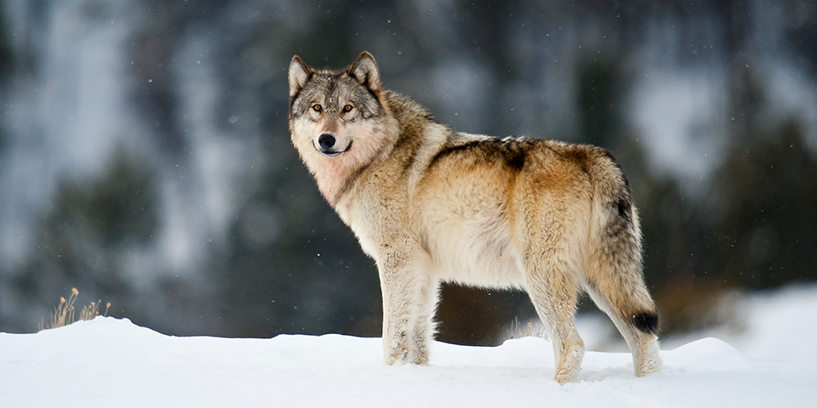
Project Application Development - Oostvaardersplassen
Presented By: Stephen Ransford Saah, Abel Sebhatu, Lucas ten Boom & Abdelhamid Lafkiri

Slide 2
Content
Introduction
Main Research Question & Sub questions
Methodology
Results
Conclusion

Slide 3
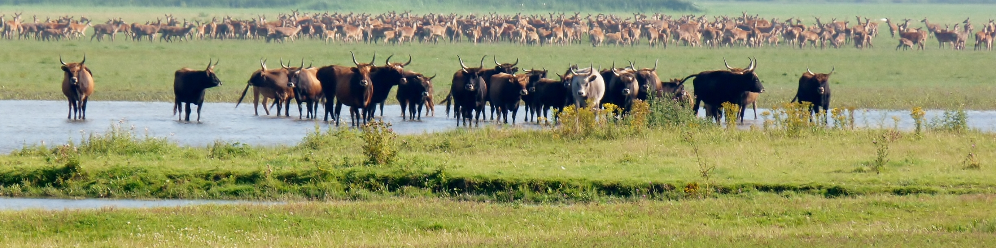
Introduction
About Oostvaardersplassen :
A nature preserve approximately 5600 ha of which 3600 ha is water of swampland and the remaining is dry land. Home to wild cattle, wild horses and deer, and other major species.
This preserve isn’t a balanced ecosystem due to the absence of a top predator and its close nature.
This team intends to to create an application to predict what happens to the growth of the animals in the preserve when wolves will be released into it.

Slide 4
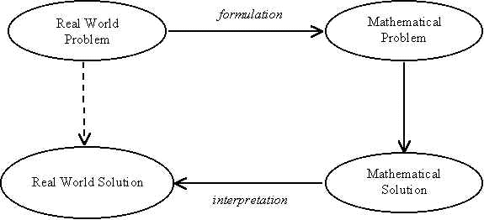
Main Research Question & Sub questions
What will happen to the population of deer, cattle and horses if releasing a number of grey wolves in the preserve (with the number of grey wolves being the free variable)
What mathematical models are available that can be used?
How will the different models be combined into one final model for the application?
Which technologies are relevant to create the application?
How can a user-friendly interface be created?
How to make the application flexible enough so the data of the preserve can be changed easily?
How will the application architecture be build?

Slide 5
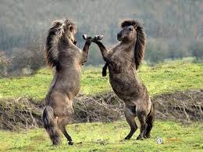
Methodology - Highlights
How will the different models be combined into one final model for the application?
Experiment, Working in iterations the model, Testing the model.
How to make the application flexible enough so that the data of the preserve can be changed easily?
Literature Study, Adaptable and Changeable data.
How will the application architecture be built?
Literature Study and Unified Modeling Language.

Slide 6

Results
Mathematical Models
Predation Growth Model: $\frac{dP}{dt}=βVP−qP$
Deer Growth Model: $\frac{dN}{dt}=rN\left(1−\frac{N}{K}\right)− αNP$
Cattle Growth Model: $\frac{dN_{1}}{dt}= r_{1}N_{1}(\frac{K_{1}−N_{1}−γN_{2}}{K_{1}})− αN_{1}P$
Horse Growth Model: $\frac{dN_{2}}{dt}= r_{2}N_{2}\left(\frac{K_{2}−N_{2}−βN_{1}}{K_{2}}\right)− αN_{2}P$

Slide 7
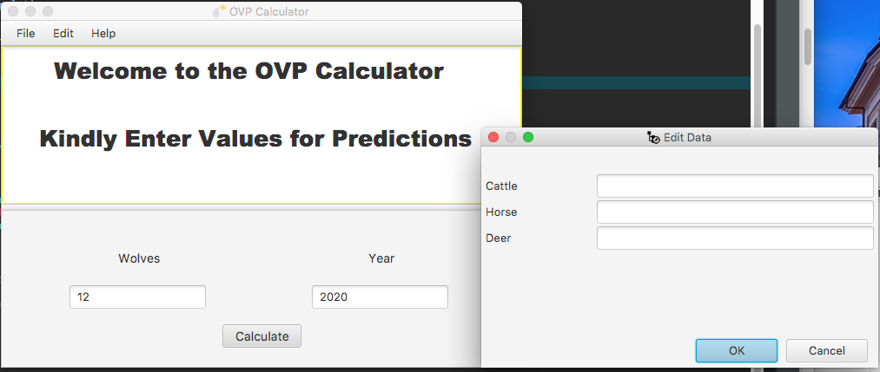
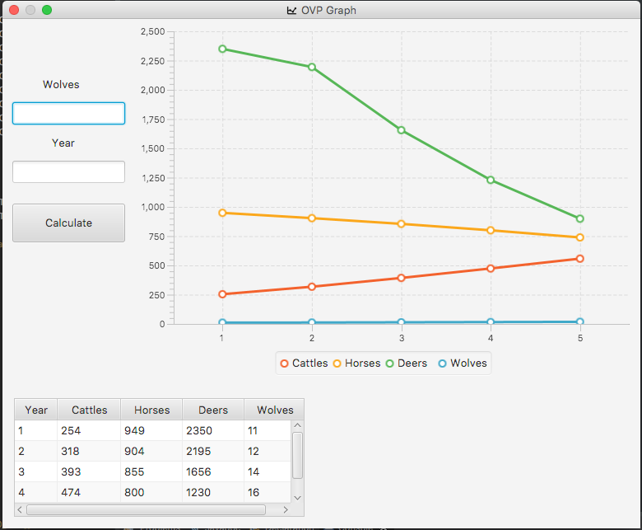
Results
Adaptable and Changeable Data

Slide 8
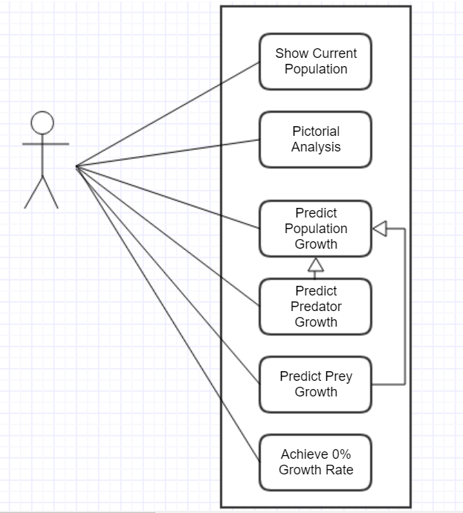
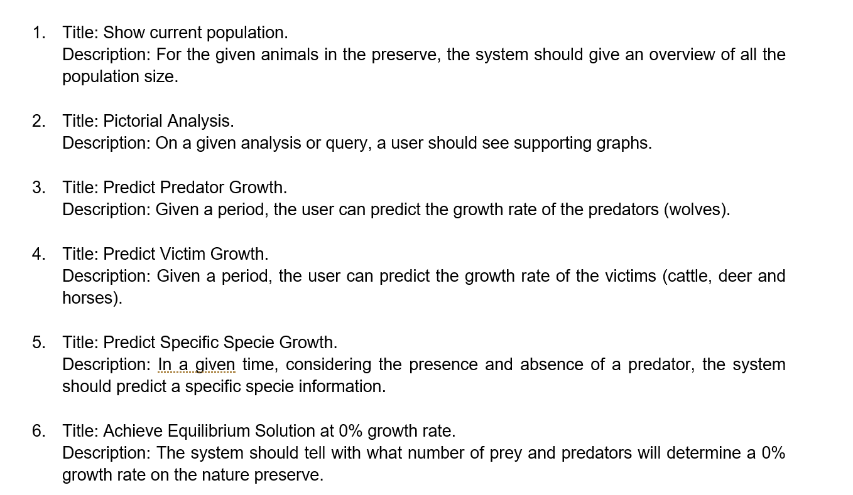
Results
Application Architecture (Also refer to Appendix – Class Diagrams)

Slide 9
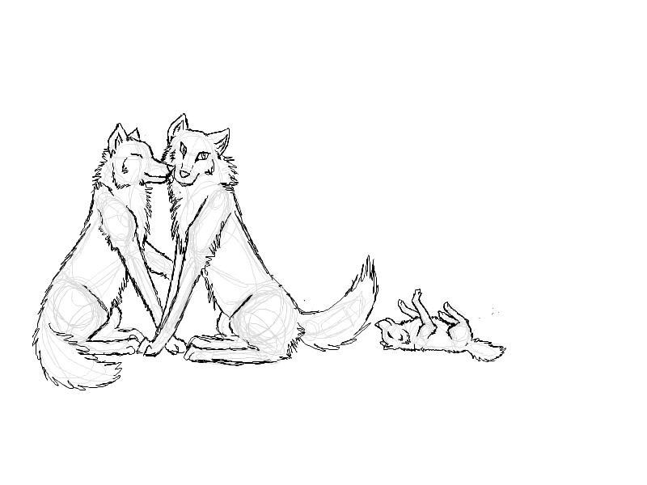
Conclusion
Four different models which are intertwined with each other were used.
Relevant technologies were Java, JavaFX and Eclipse IDE.
Using data text files made the application flexible for upcoming changes.
Application architecture was created using Unified Modeling Language.
Releasing wolves can be a solution.
A full application

Slide 10

Thanks for listening. Any Questions??

Slide 11
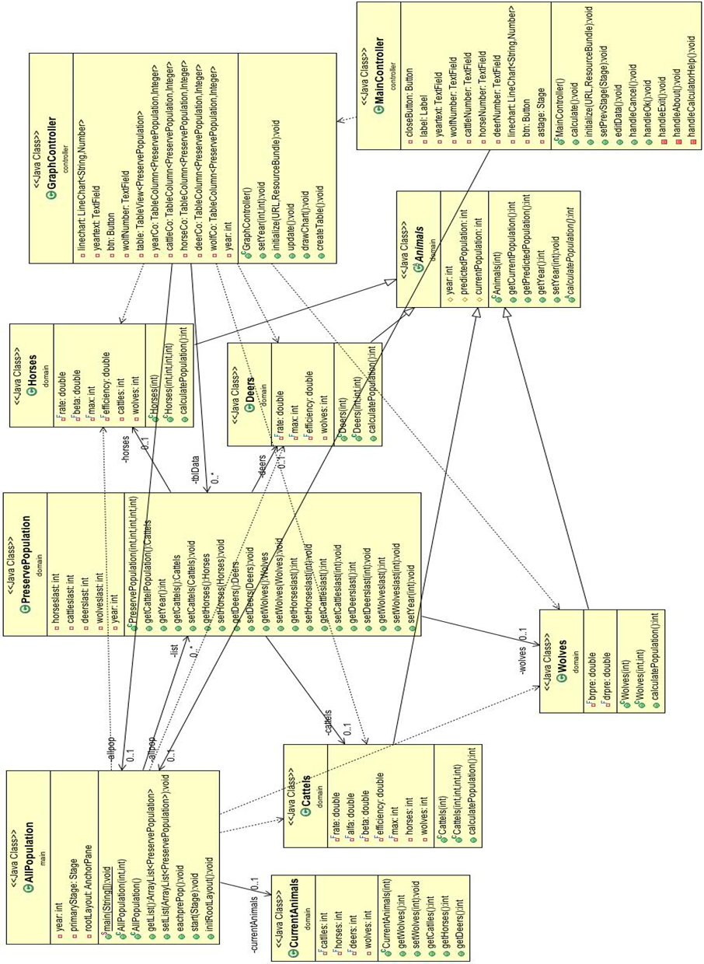
Appendix A – Class Diagram

